Slide 1
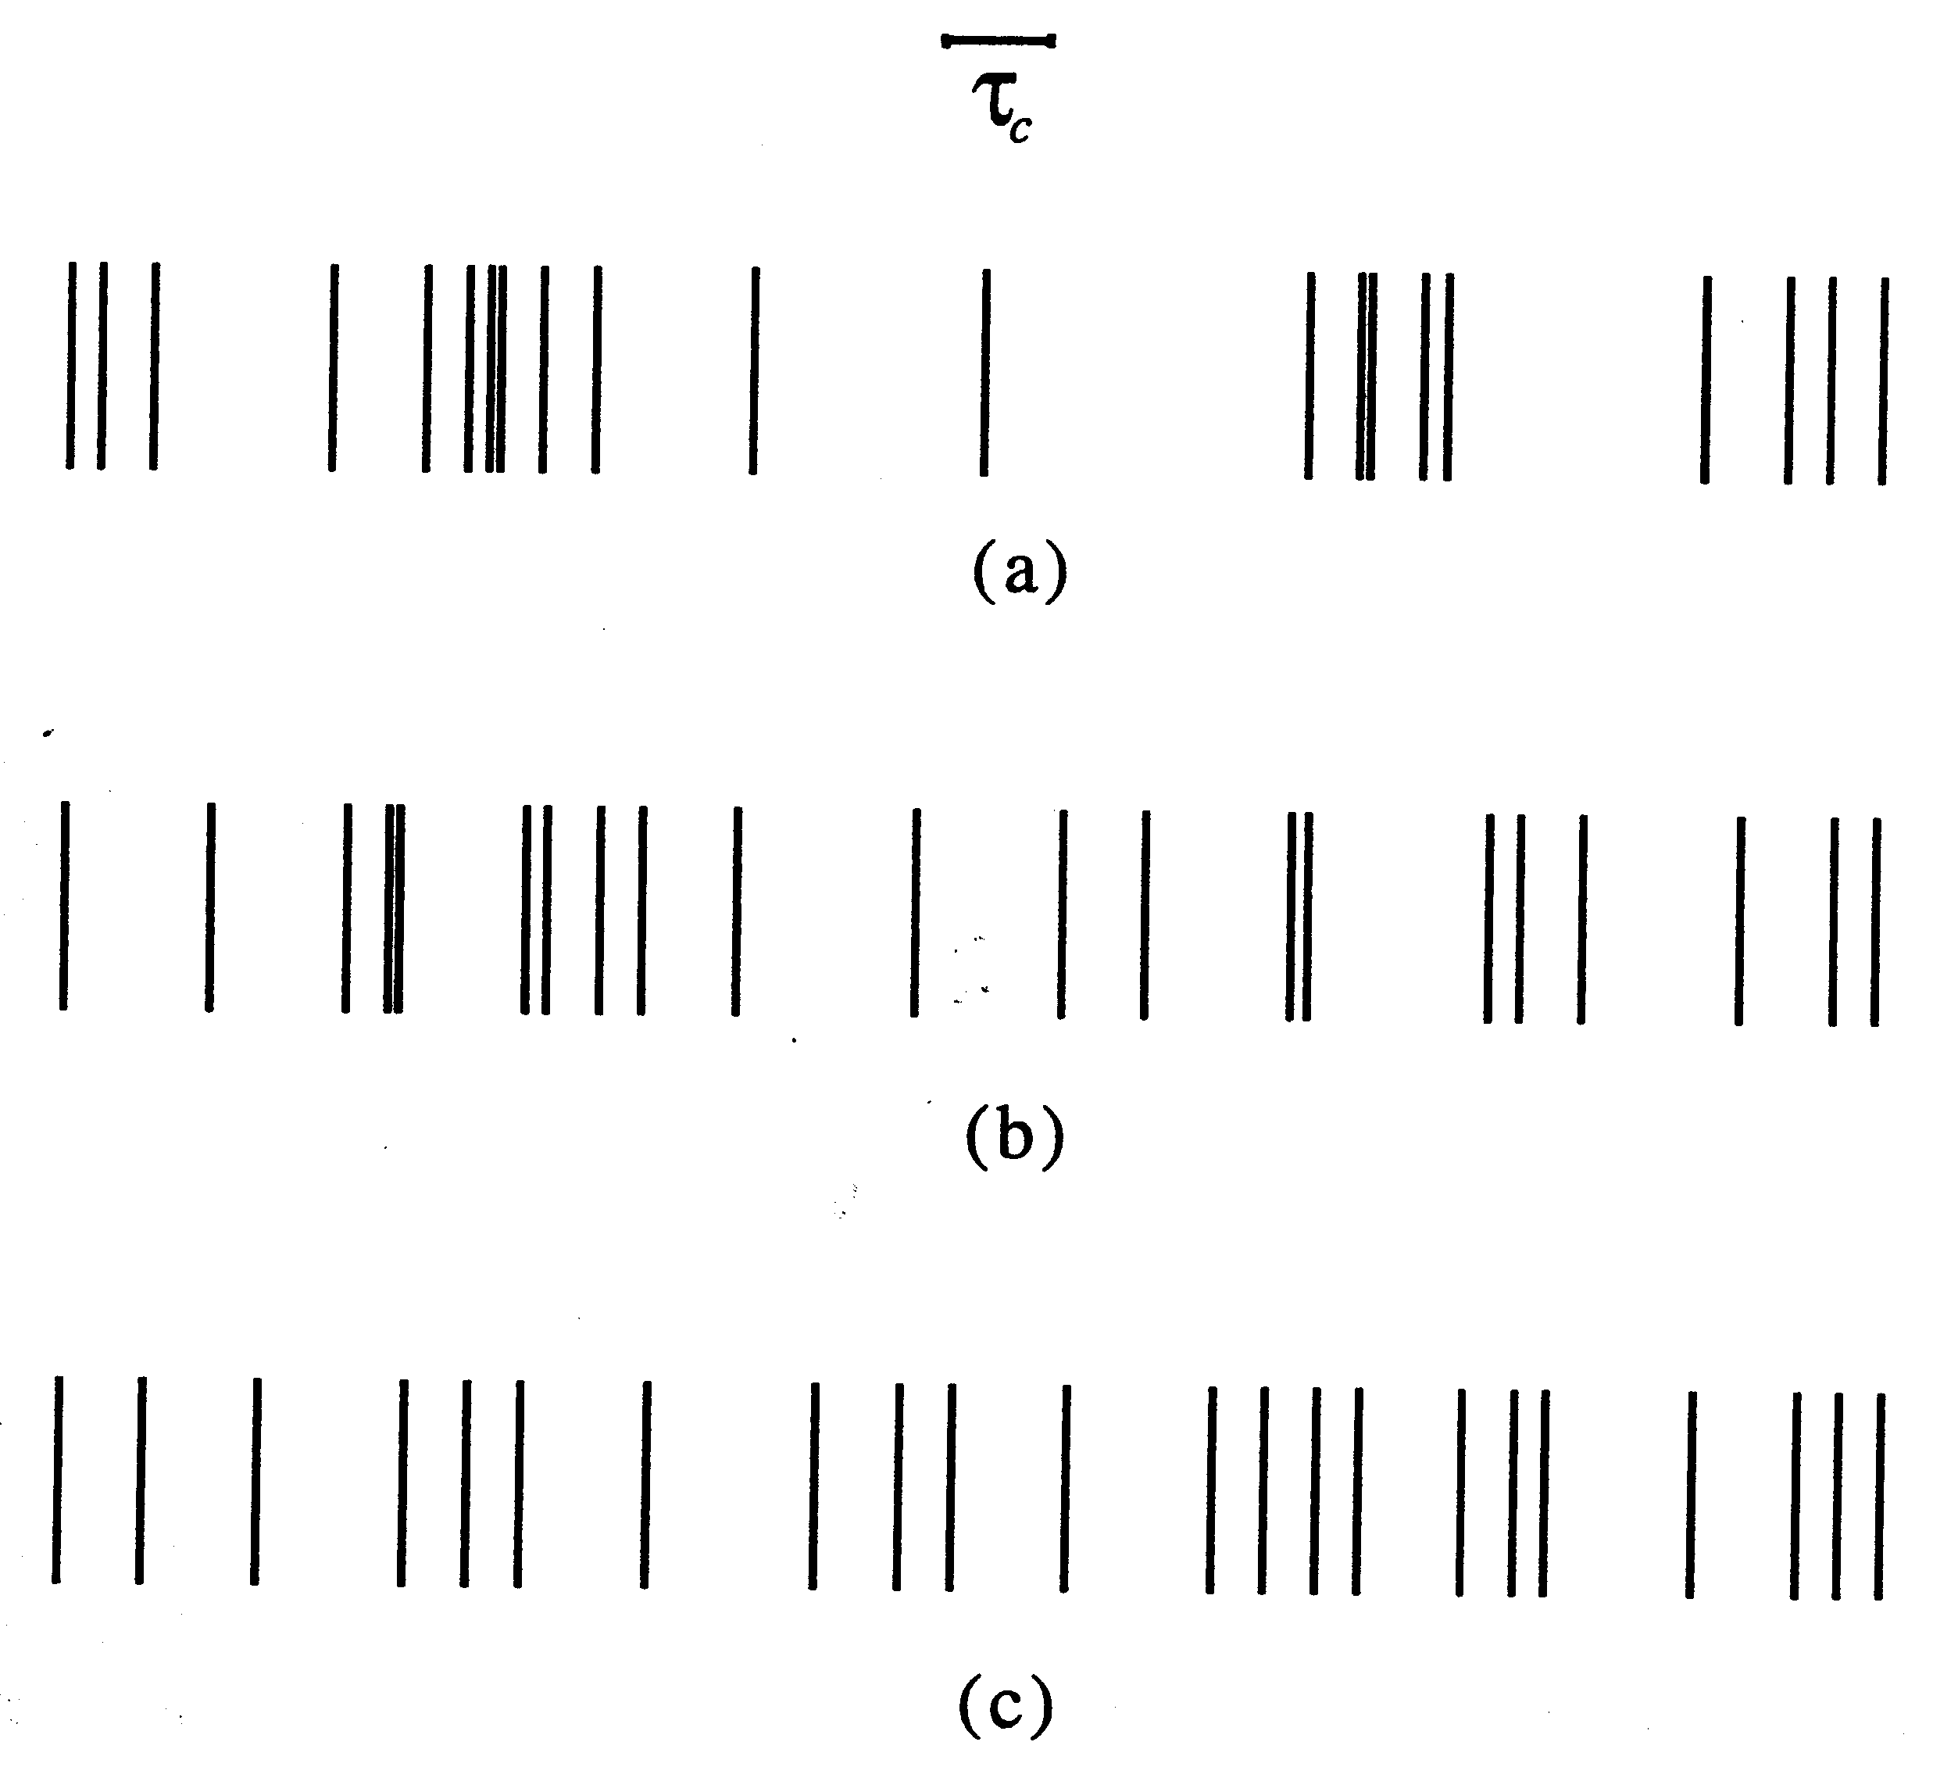
Photonenstatistik
Photon Bunching
Poissonverteilt
Photon Antibunching
Scully & Zubairy, Quantum Optics, Cambridge University Press (1997)

Slide 2
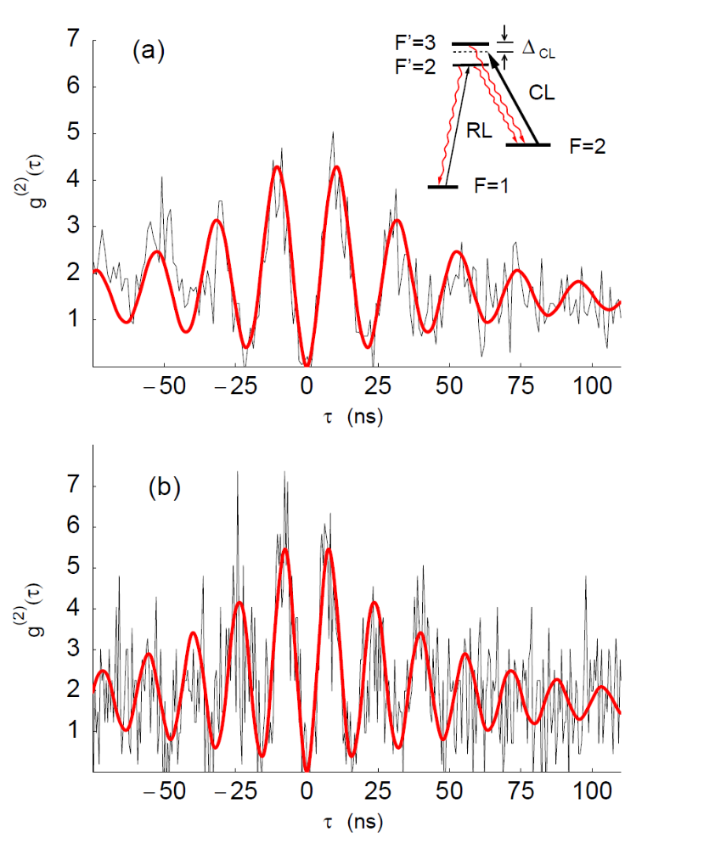
2nd order coherence function
Measured g(2) function of a single Rb atom

Slide 3
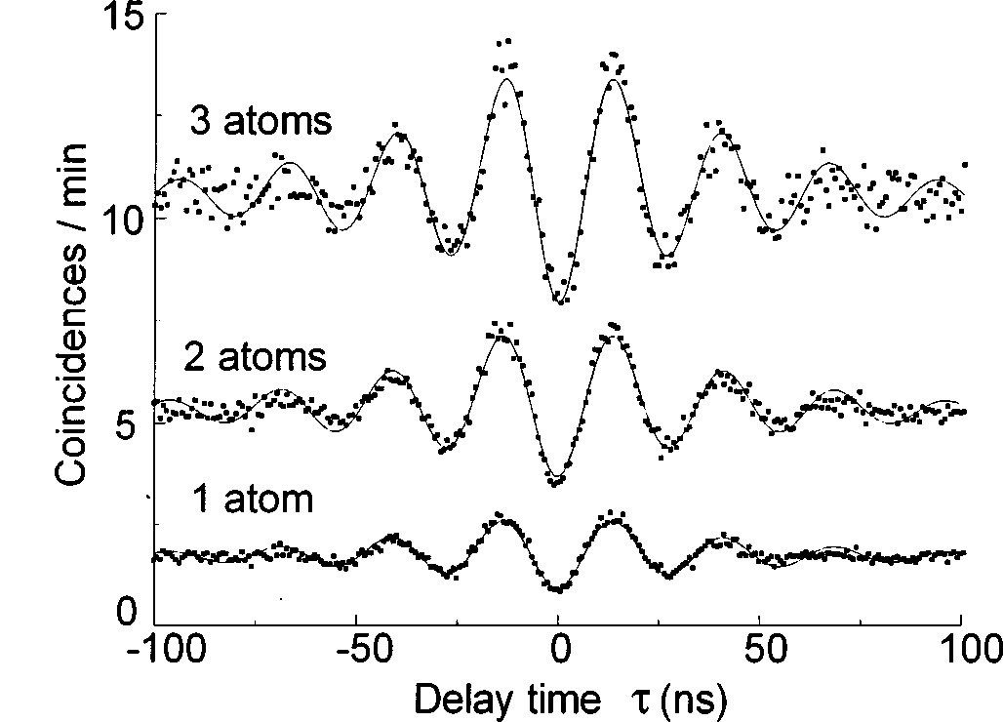
Resonanzfluoreszenz
V. Gomer et al., Phys. Rev. A 58, R 1657 (1998)

